Slide 1



Building the Linux OS using Buildroot
Presented by Group 5
Peixing Yang
Hui Lin

Slide 2

Our team
Alexander (Peixing Yang)
Alan (Hui Lin)
2096322
p.yang@student.fdu.edu
2072293
h.lin@student.fdu.edu

Slide 3

Wonderful Linux journey
01
02
03
04
Introduction
Environmental Installation
Virtual machine
Operating system
Software tools
Project Background
What is Buildroot ?
Configuration
Verification & Conclusion
Menuconfig
Compile and build
Verification
Problems & Solutions
Conclusion

Slide 4

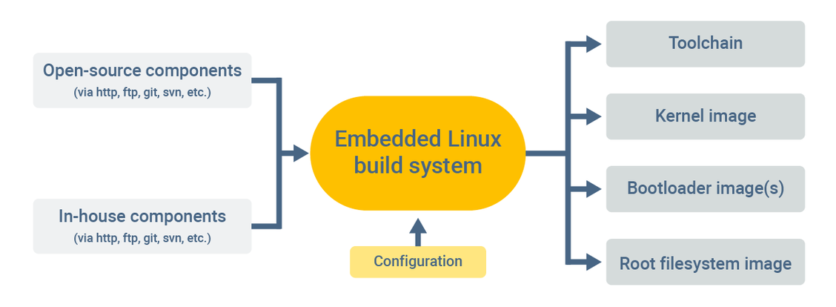
What is Buildroot?
01
Introduction
Usage and advantages
Basic workflow

Slide 5
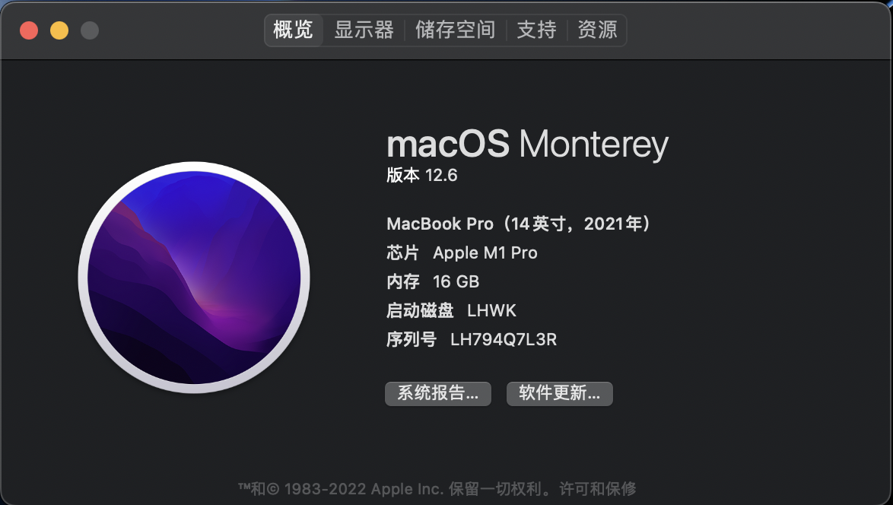

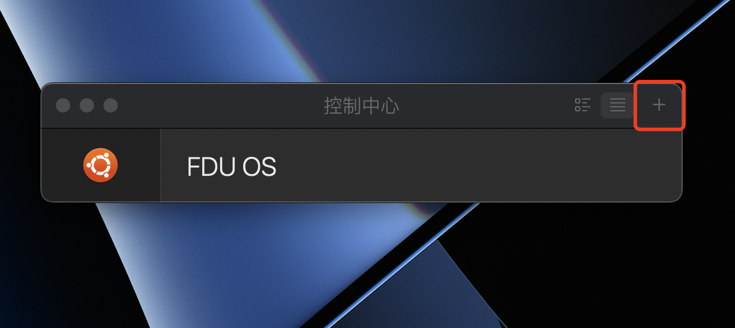
02
Environmental Installation
1.Based on laptop(Macbook) hardware environment
2. Install the virtualization tool (Parallels Desktop)
3. Select and install the operating system for the virtual machine

Slide 6

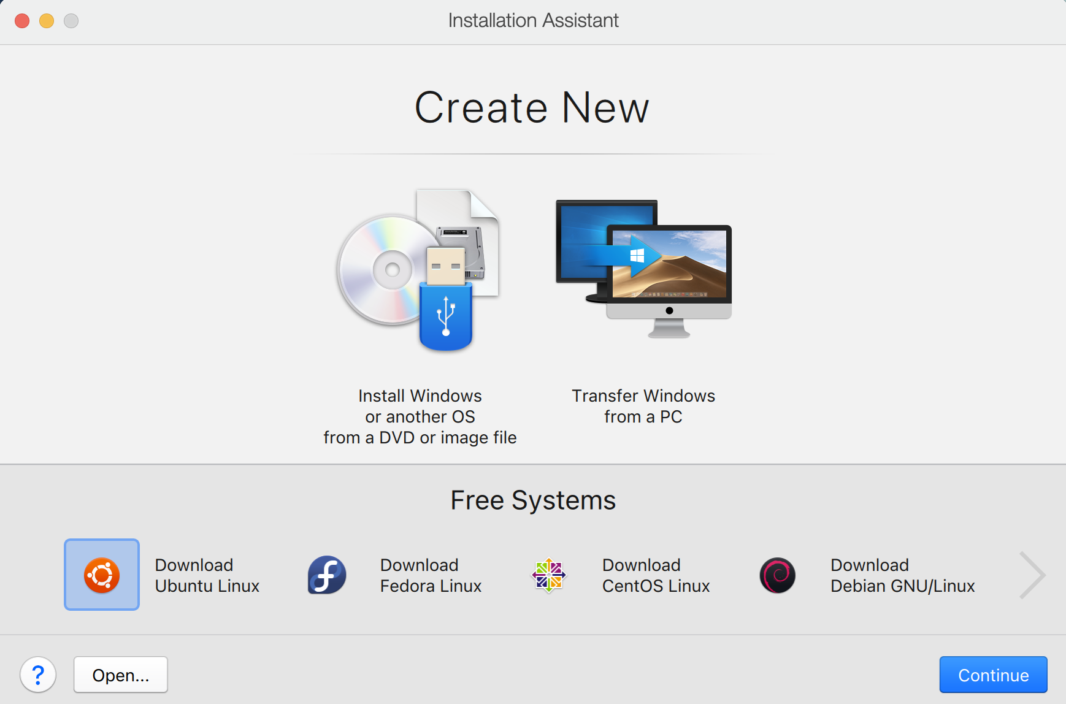
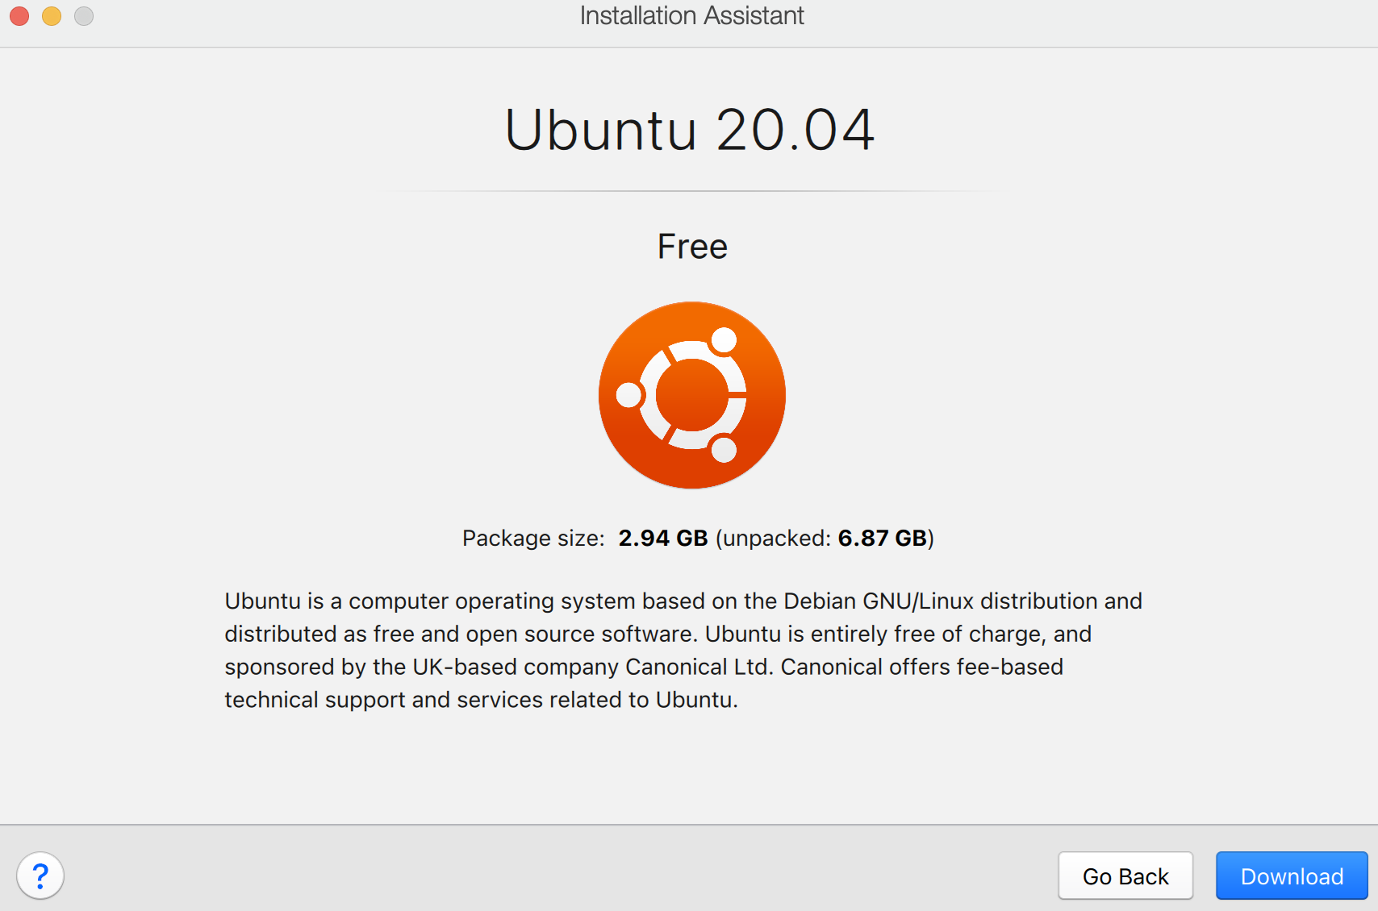
Choosing the suitable virtual machine OS (Ubuntu)
02
Environmental Installation

Slide 7
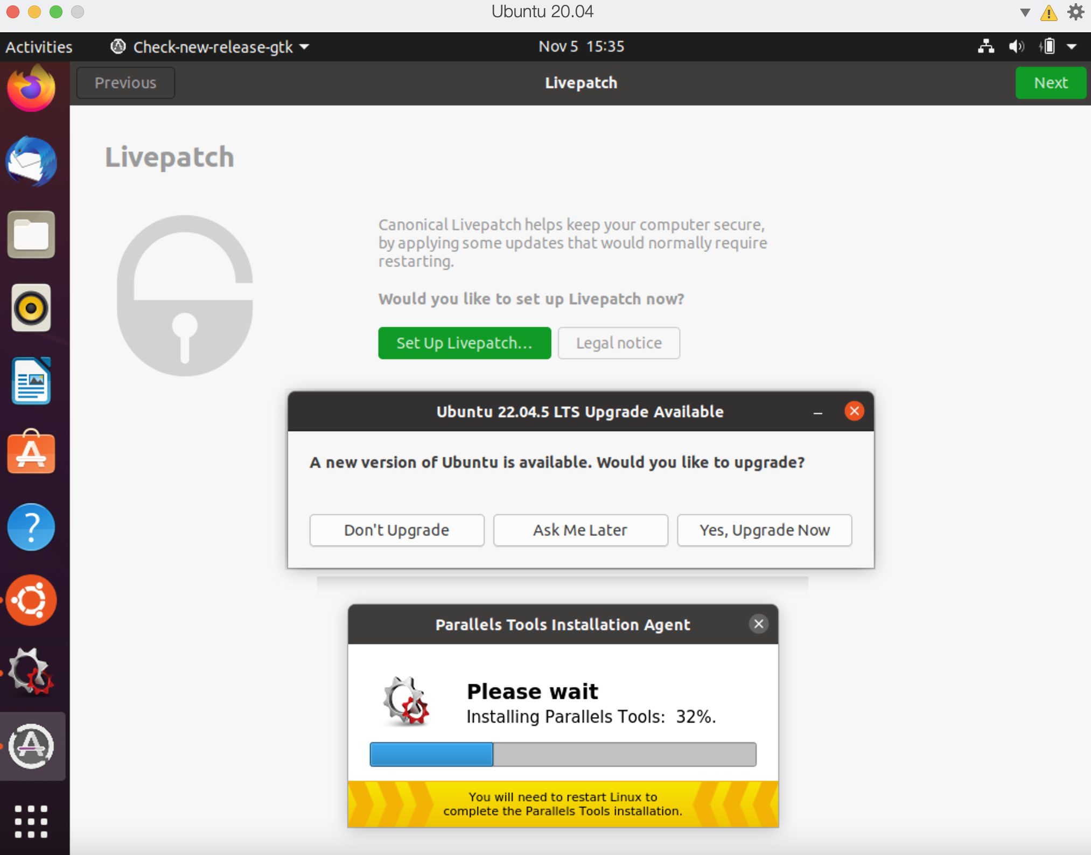
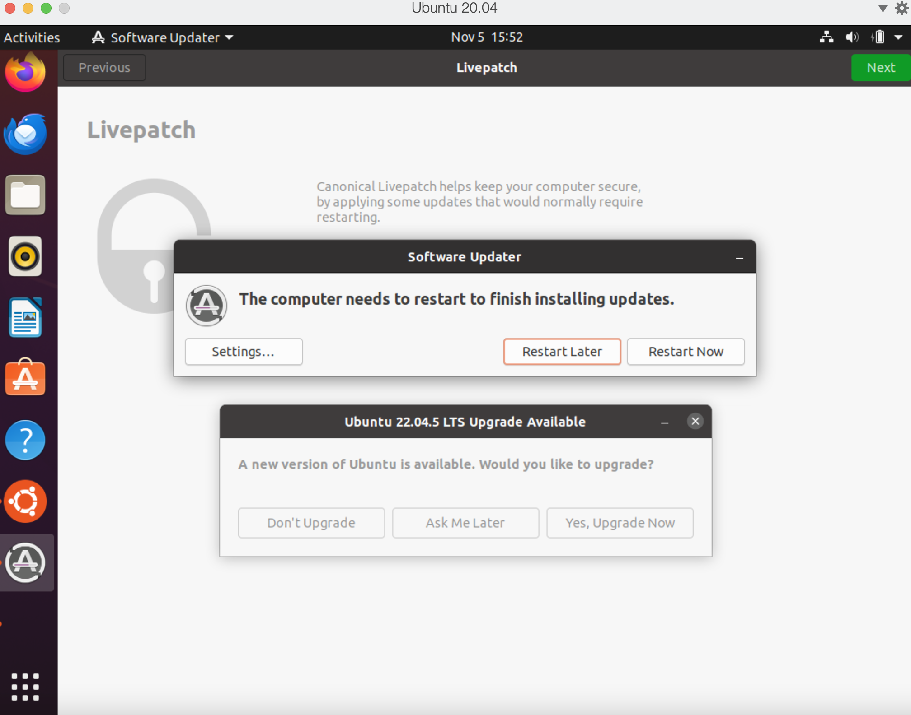
Update all related components
02
Environmental Installation

Slide 8
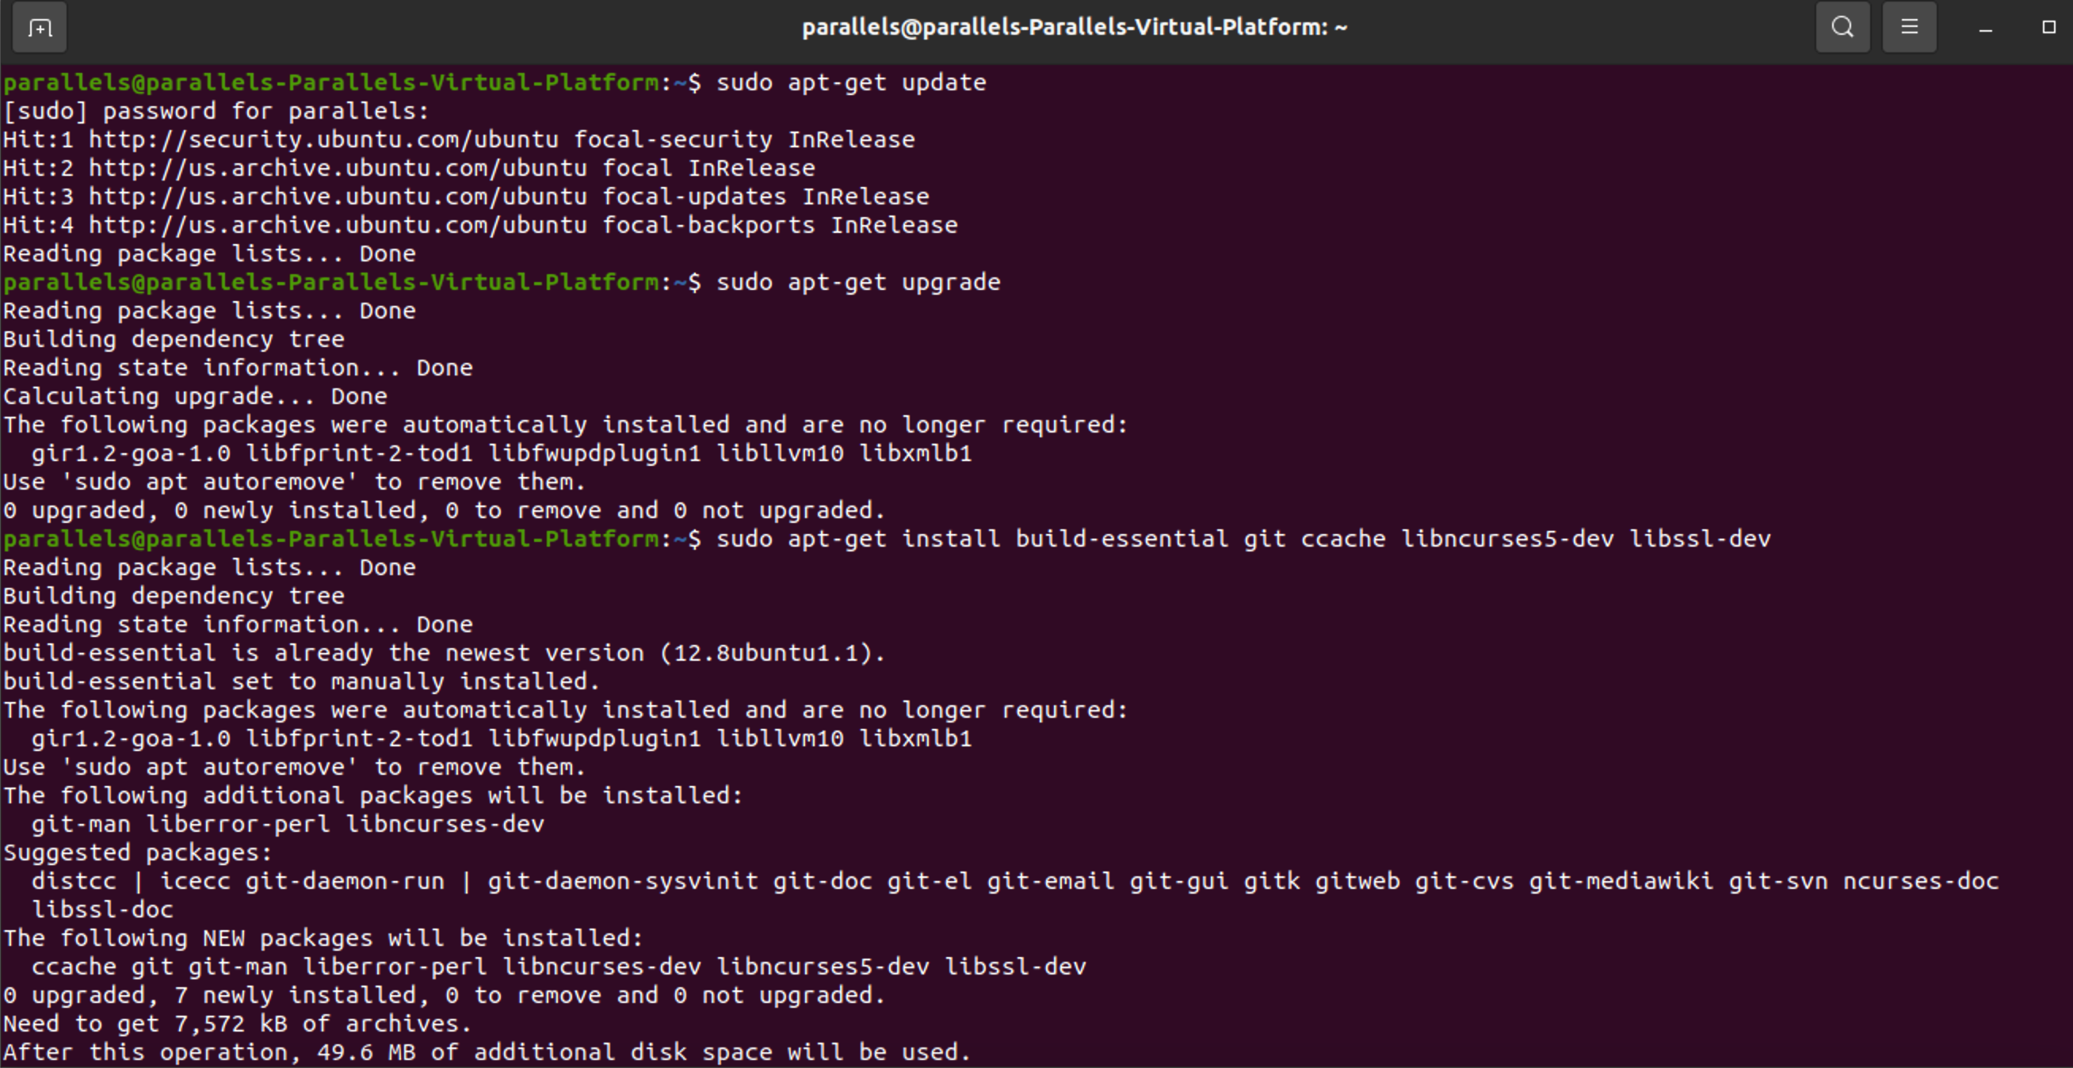
Download & Install Buildroot
02
Environmental Installation

Slide 9
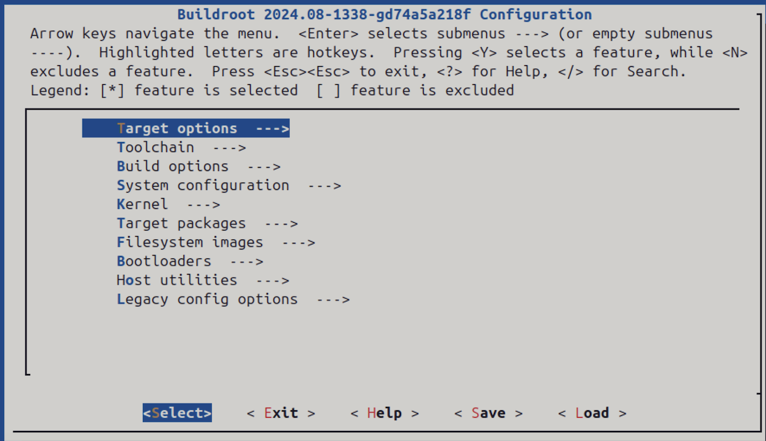
Enter the configuration menu
03
Configuration

Slide 10

Briefly review each item-1
03
Configuration
[Usage] It helps choose and set up the toolchain needed to build the embedded system. Its settings make sure the code for the target platform is compiled correctly.
[Key Options]
--"Toolchain type" (like external toolchain or the one that comes with Buildroot),
--"Toolchain origin" (such as pre - installed toolchain or custom toolchain),
--"Toolchain path" (if using an external toolchain, we need to say where it is),
--"GCC compiler version" (choose the version of the GCC compiler).
[Usage]To set up various parameters related to the specific hardware platform.
[Key Options]
--"Target Architecture" (like ARM, x86, etc.),
--"Target Architecture Variant" (such as specific models of ARM Cortex - A series),
--"Target Board" (choose a particular hardware development board model),
--"Floating point strategy" (decide how to handle floating - point operations).

Slide 11

Briefly review each item-2
03
Configuration
[Usage] For setting up the overall settings of the embedded system. These settings affect how the whole system works and what it can do.
[Key Options]
--"System hostname" (set the system's host name),
--"Root password" (set the root user's password or choose if you want to use a password),
--"Enable root login" (choose if the root user can log in).
[Usage] Adjust how the building is done, the optimization level, and the output directory structure.
[Key Options]
--"Build target" (choose what to build, like a bootable image file, library files, or just the toolchain),
--"Build directory" (say where the building process should put the output).

Slide 12

Briefly review each item-3
03
Configuration
[Usage] add or remove software packages based on what the system needs to do.
[Key Options]
Note: The specific options depend on the types of software packages.
[Usage] Choosing the kernel version and turning on or off specific kernel modules. making the kernel do what the system needs.
[Key Options]
--“Kernel version” (from official stable versions or custom ones),
--“Kernel configuration” (go into a detailed interface to choose which kernel features and drivers to turn on or off, like file system support, network protocol support, device drivers).
[Usage] set up the type and related parameters of the filesystem image to be built.
[Key Options]
--"Filesystem type" (choose the type of filesystem, like ext4, squashfs, jffs2),
--"Filesystem size" (set how big the filesystem should be to fit the storage of the target device), ---"Enable compression" (choose if compress the filesystem to use less storage space)

Slide 13

Briefly review each item-4
03
Configuration
[Usage] For choosing and setting up the bootloader, which starts the system by initializing the hardware, loading the kernel.
[Key Options]
--"Bootloader type" (choose the type of bootloader, like U - Boot, GRUB),
--“Bootloader configuration” (go into the detailed configuration of the chosen bootloader, like setting start - up parameters, kernel loading address).
[Usage] the tools and options related to the host computer (the one running Buildroot).
[Key Options]
--"Host libraries" (Install libraries necessary for compiling host utilities),
--“Host toolchain utilities” (Build the necessary tools for cross-compilations, such as binutils, gcc).
[Usage] for being compatible with old versions of the configuration or providing some options that are not used often but might be needed in certain situations.
[Key Options]
Note: The specific options can be different in different Buildroot versions.

Slide 14
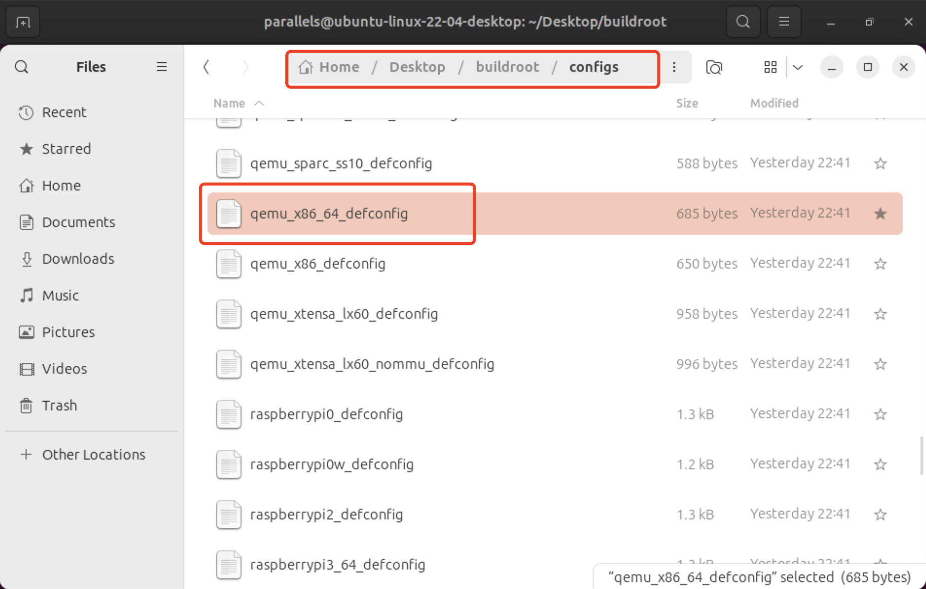

Quick configuration strategy
03
Configuration
Step1: Select a common server system configuration in the default configuration directory of buildroot. (eg: qemu_x86_64)

Slide 15
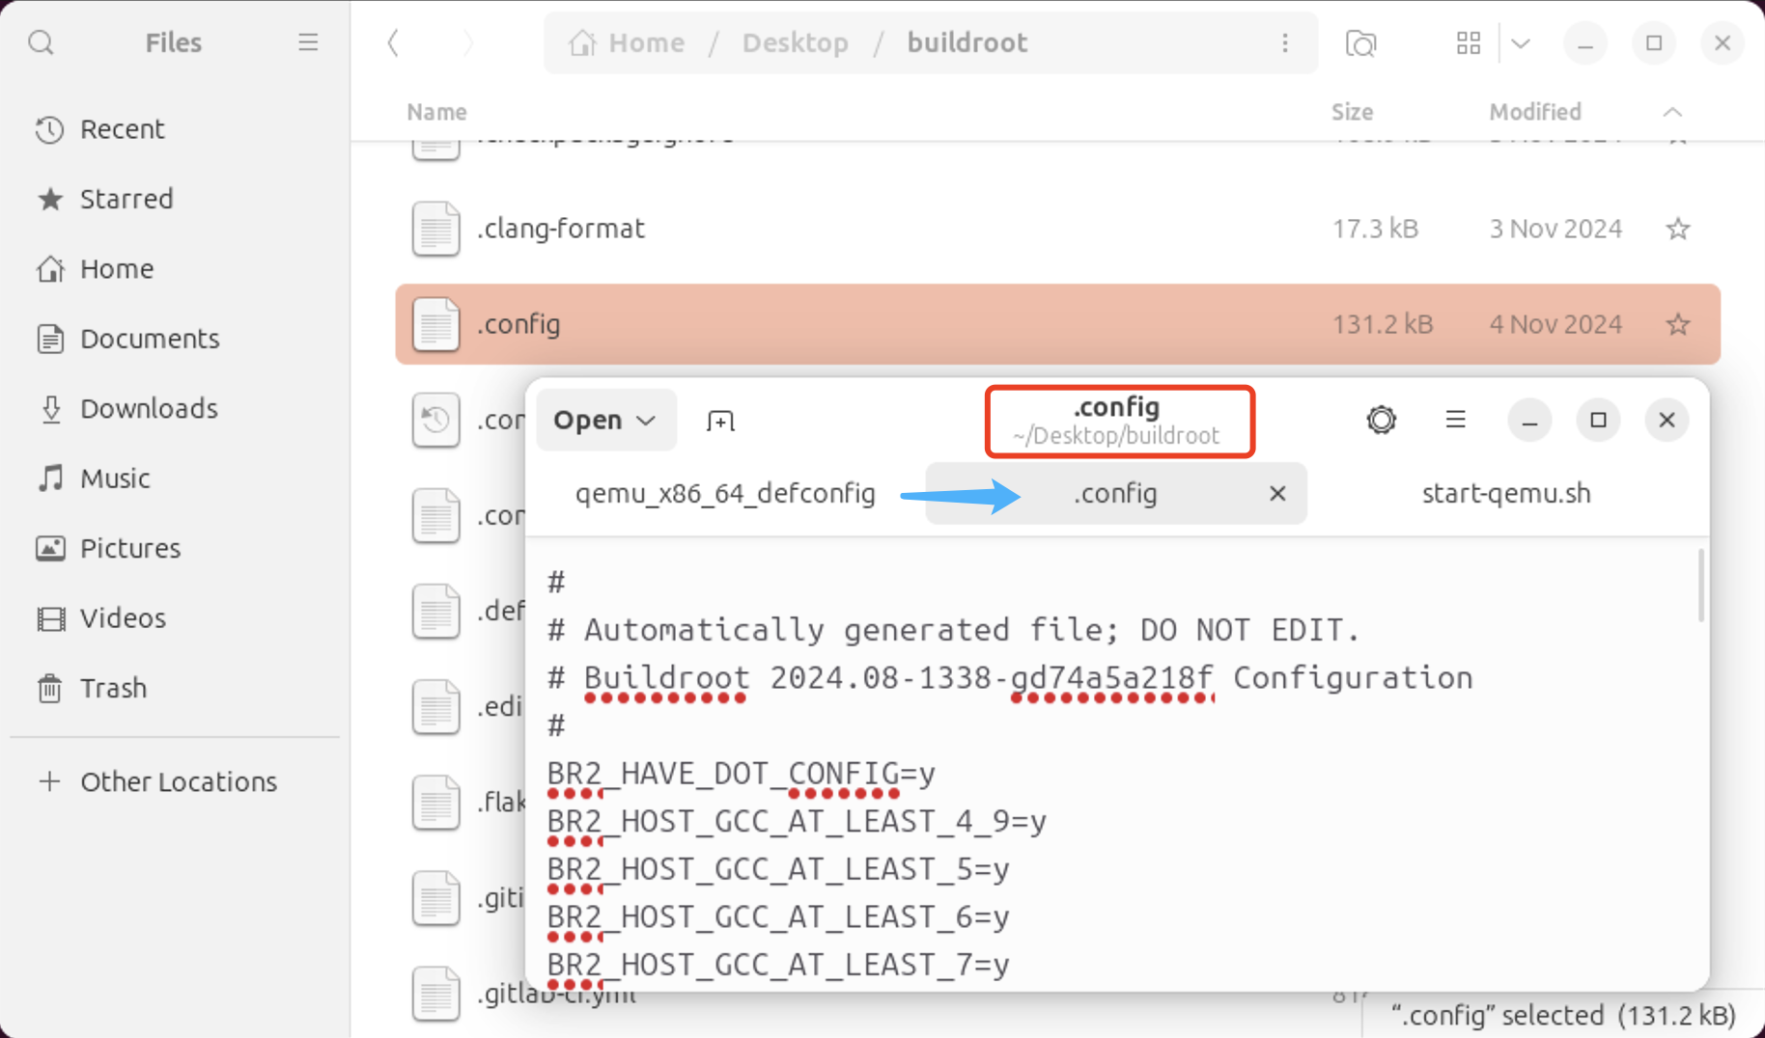
Quick configuration strategy
03
Configuration
Step2: Copy all the default configuration file contents to the “.config”(hidden file) in the buildroot main directory and replace the original contents. (Note: For safety reasons, back up before replacing!)

Slide 16
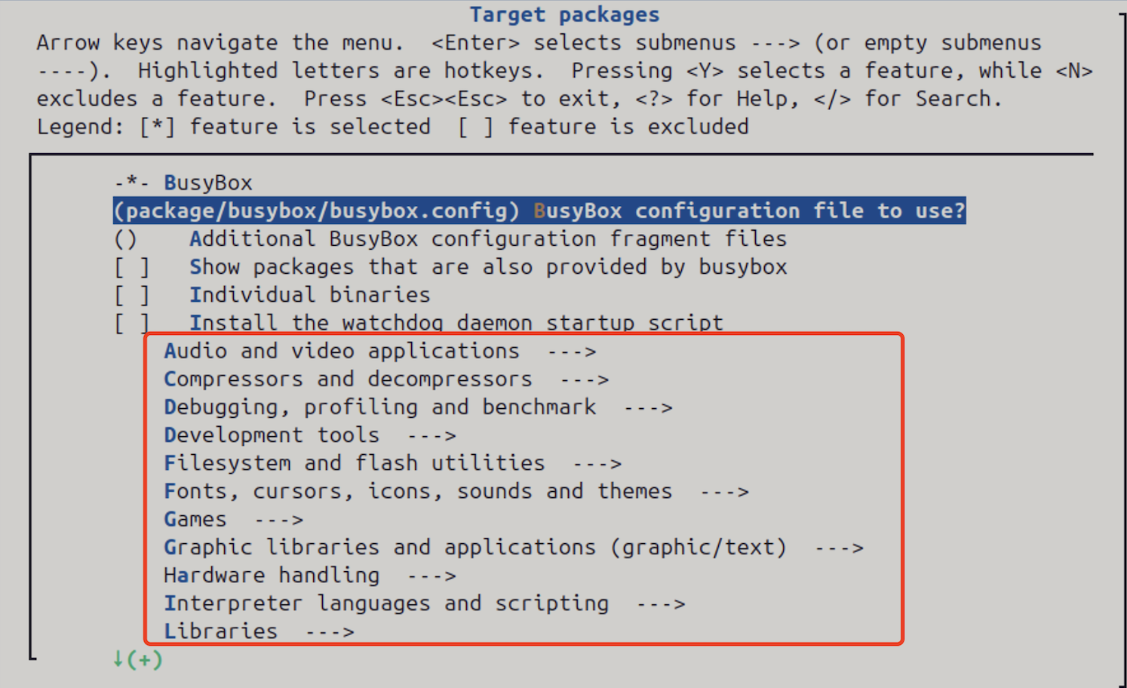
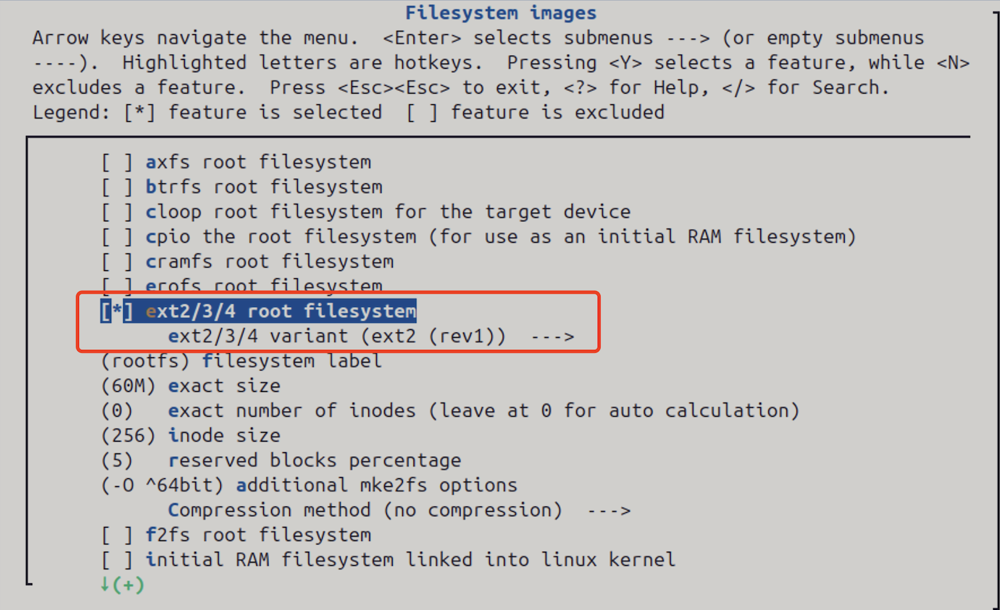
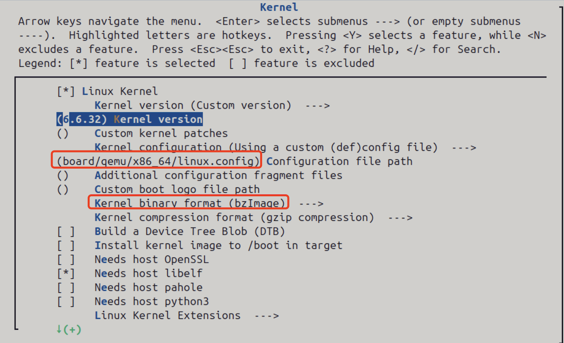
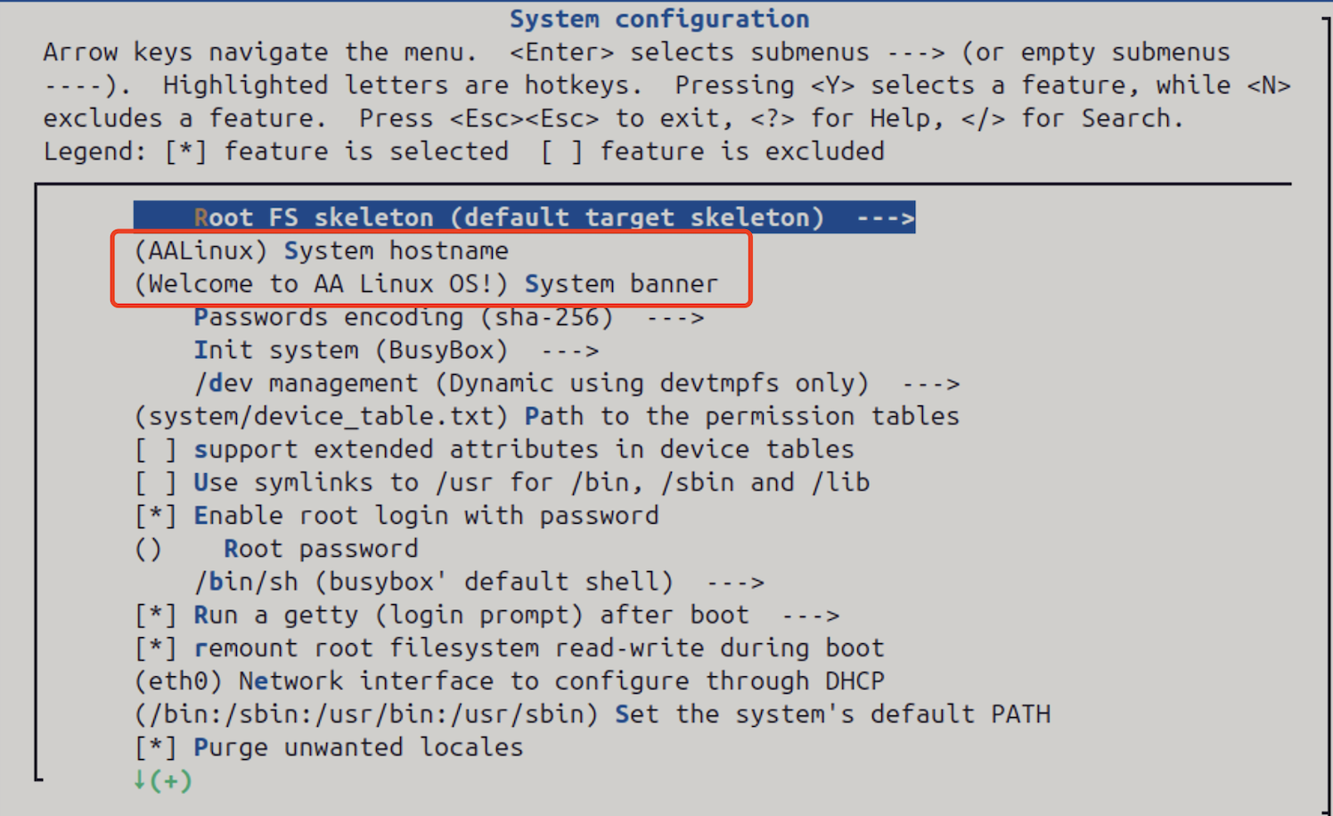
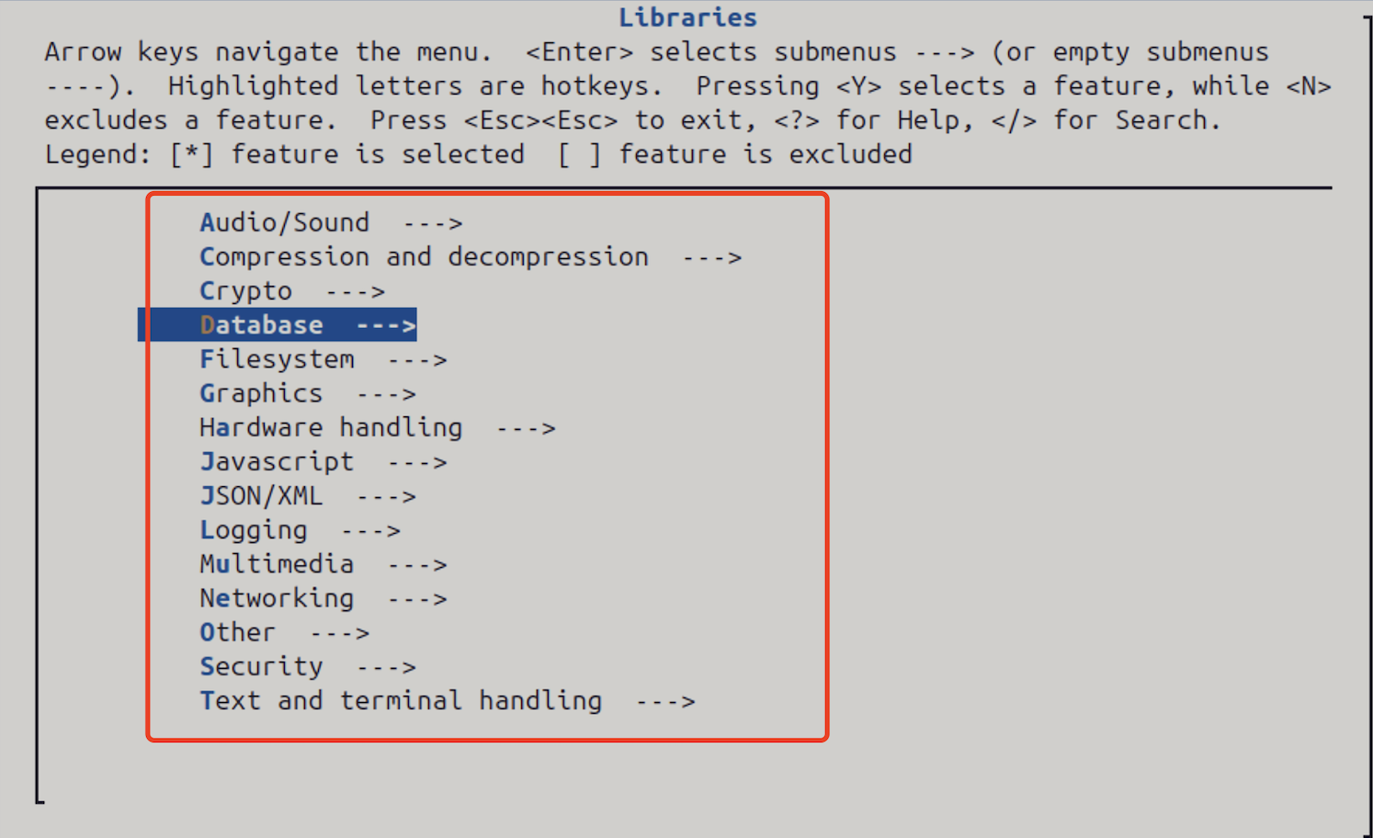
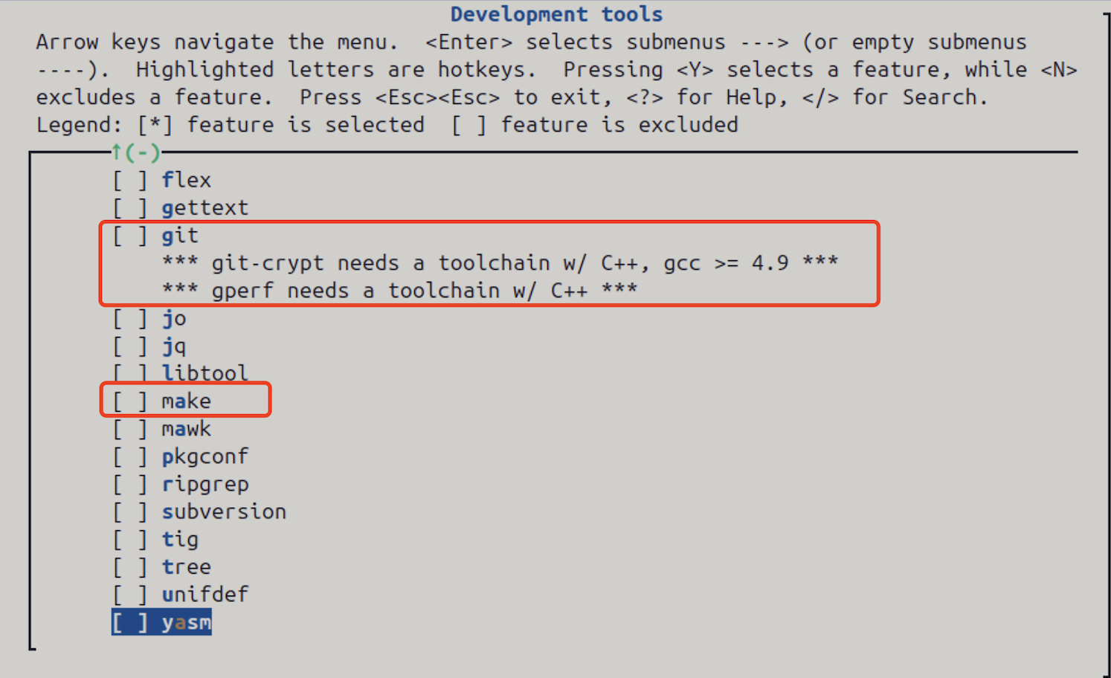
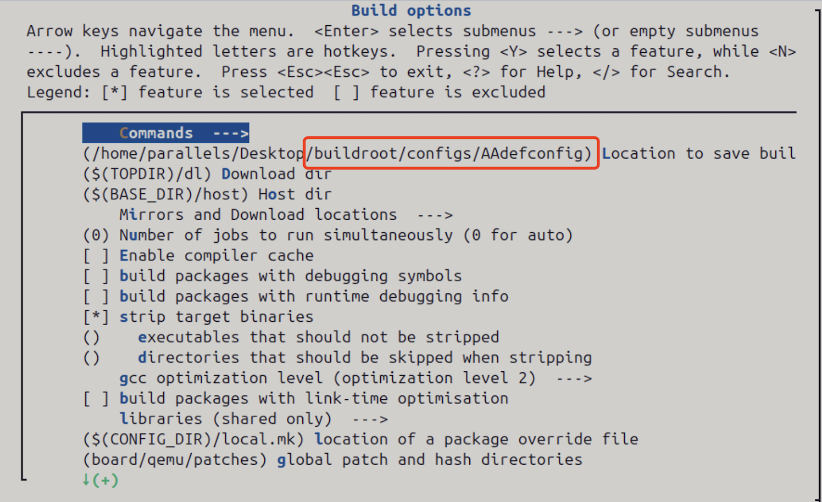
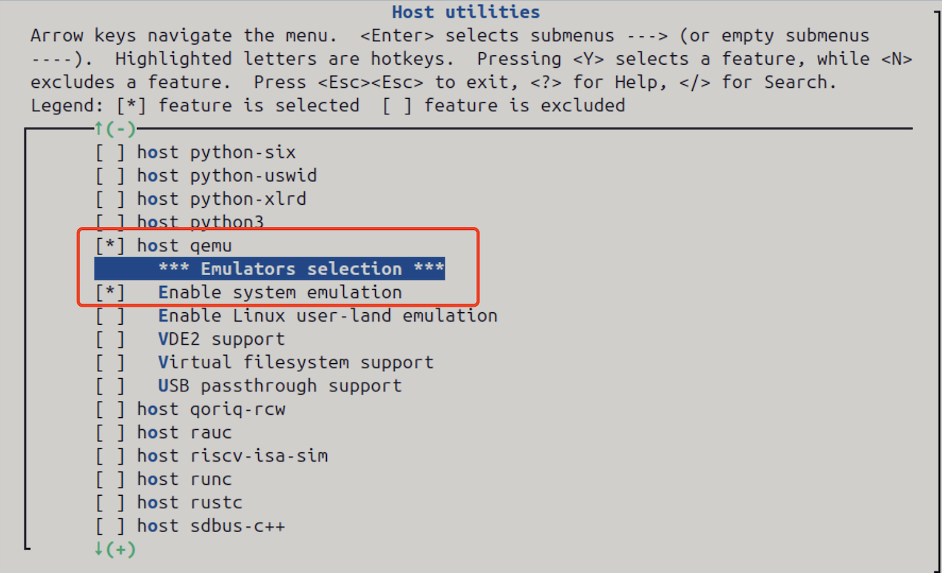

Quick configuration strategy
03
Configuration
Step3: Customize our new AA Linux system based on the existing configuration of 64-bit x86 servers.

Slide 17
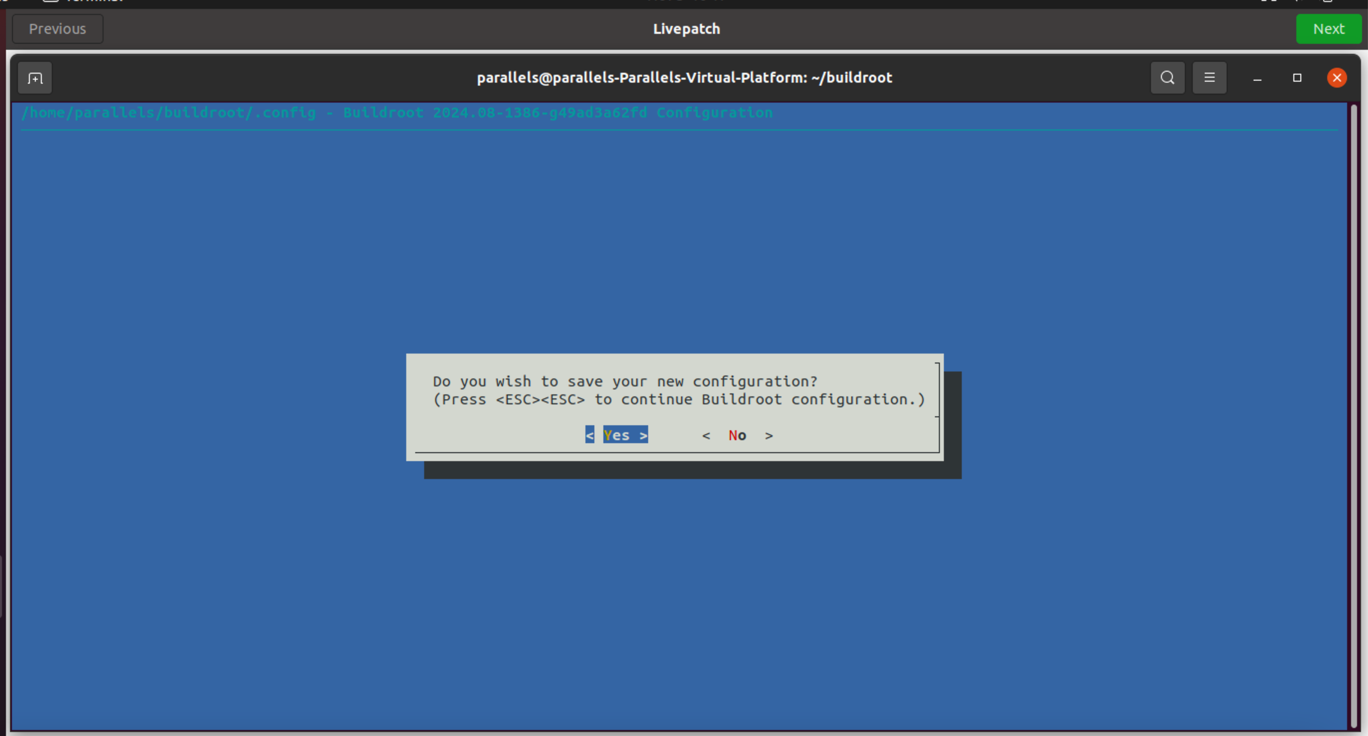

Save the configuration before making a new Linux
03
Configuration

Slide 18
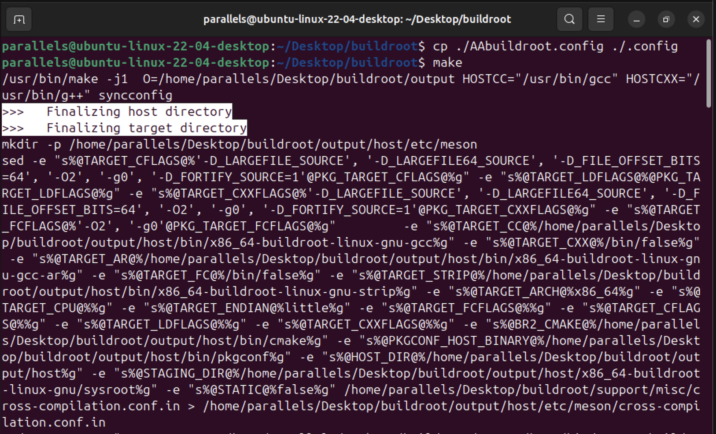

It took nearly an hour and a half to complete the execution.
03
Build a new Linux

Slide 19
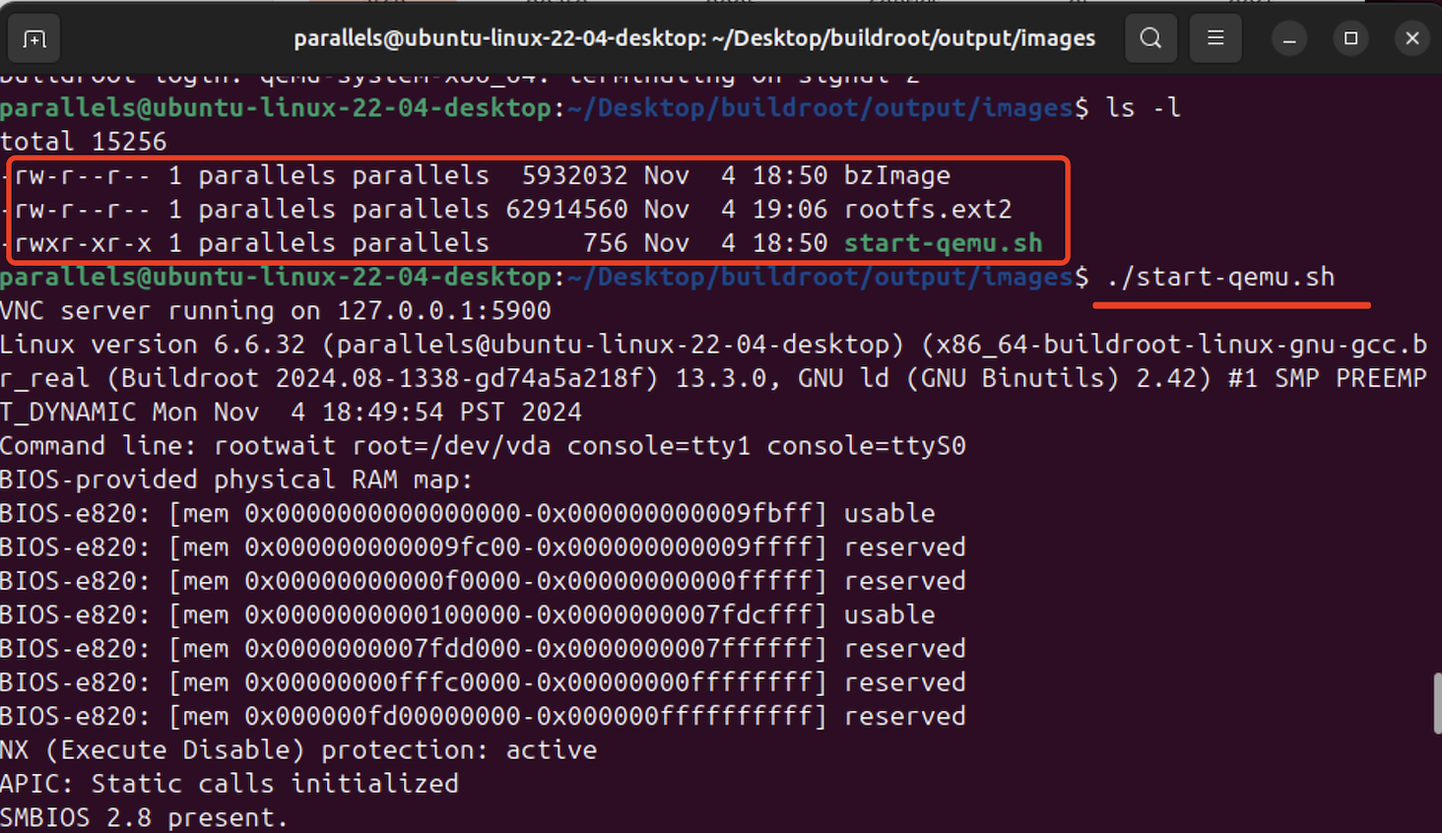
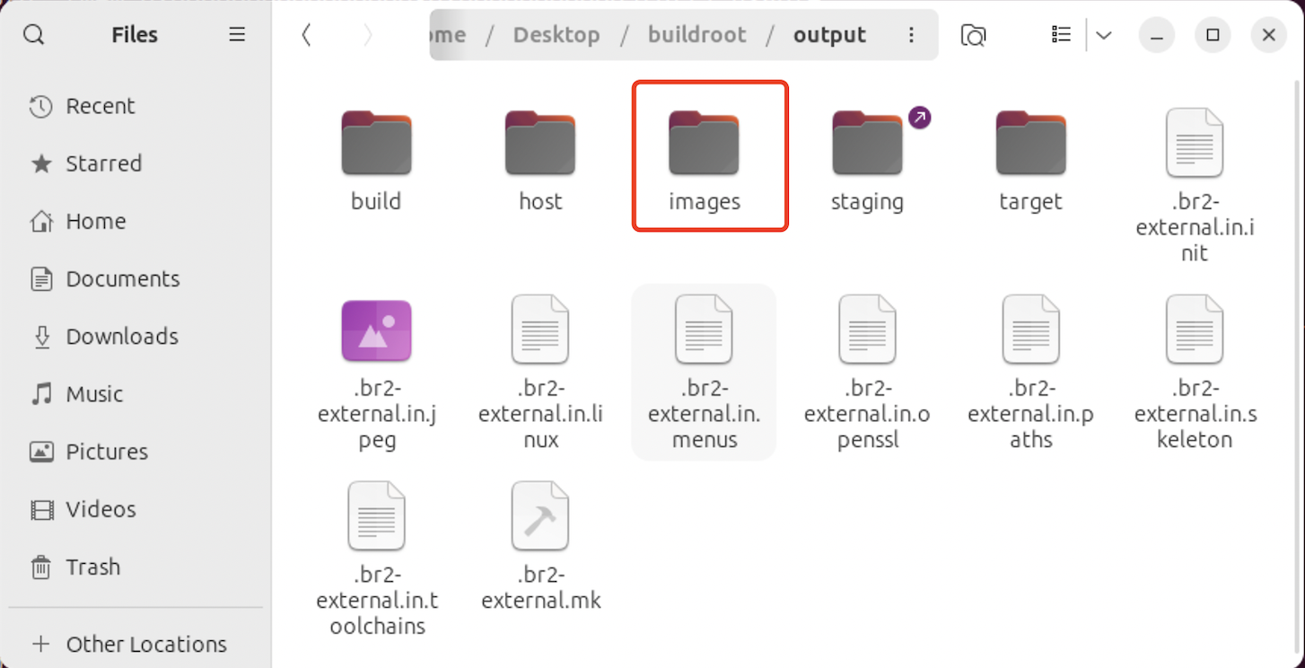
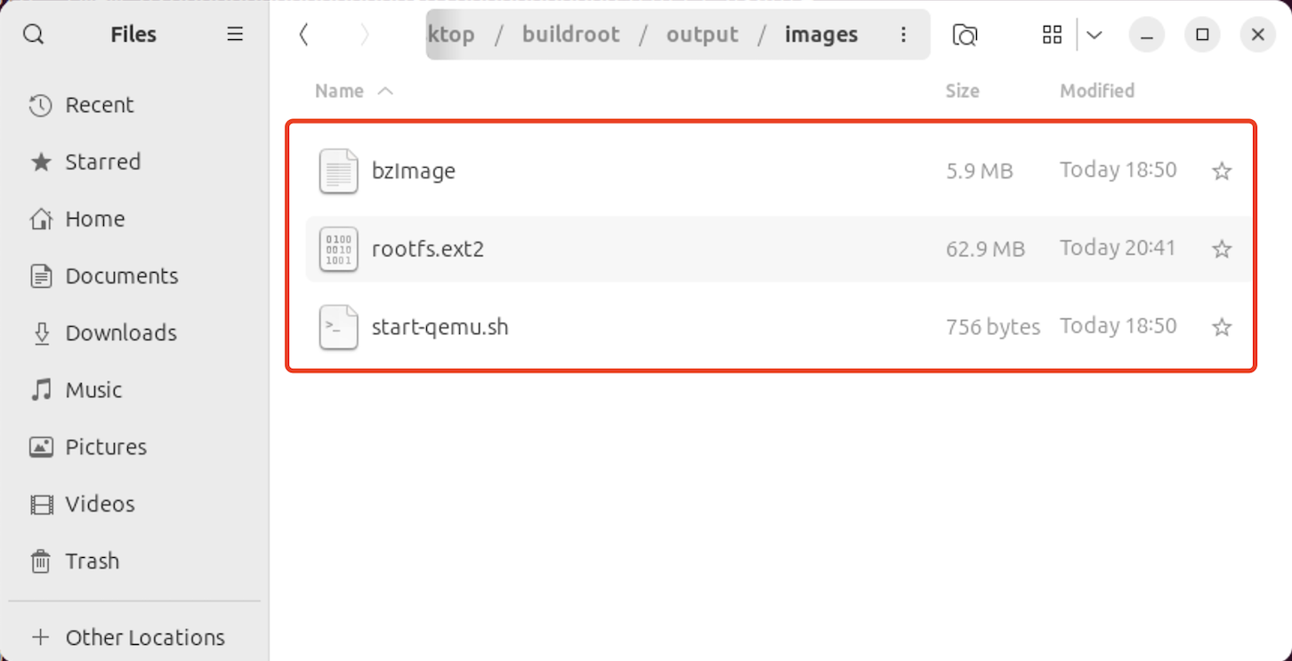
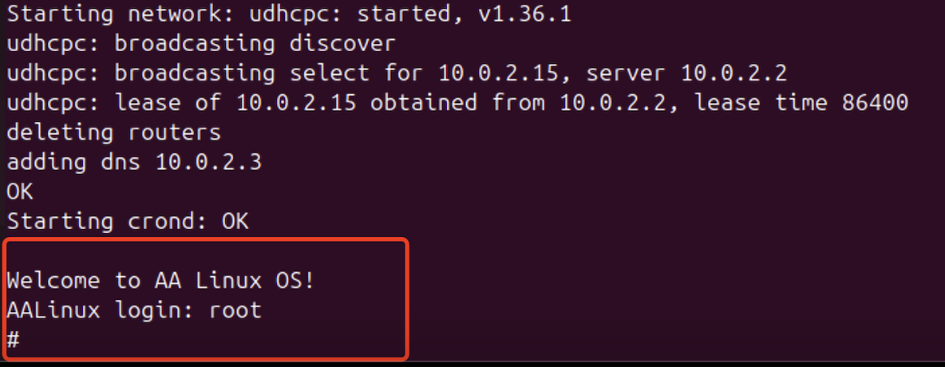

Output after make succeeds
04
Verification – Start & Login

Slide 20
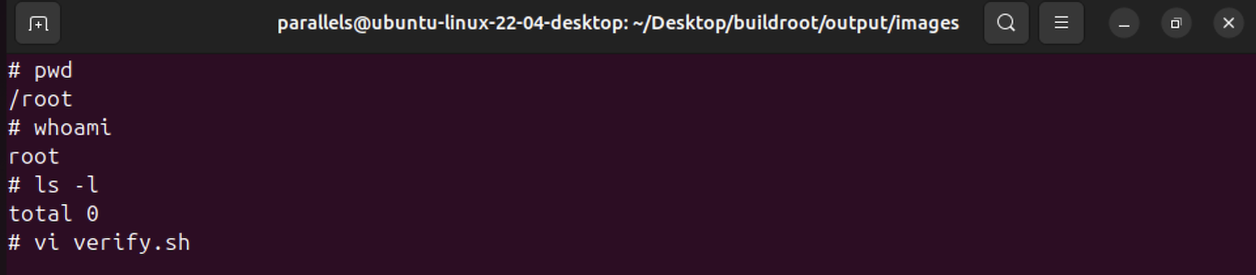


Verify via the command line.
04
Verification – Test the basic functions of AA Linux.

Slide 21
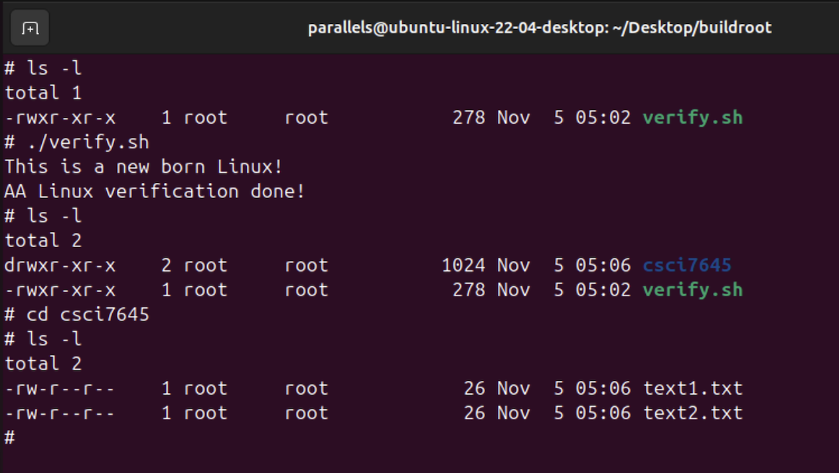
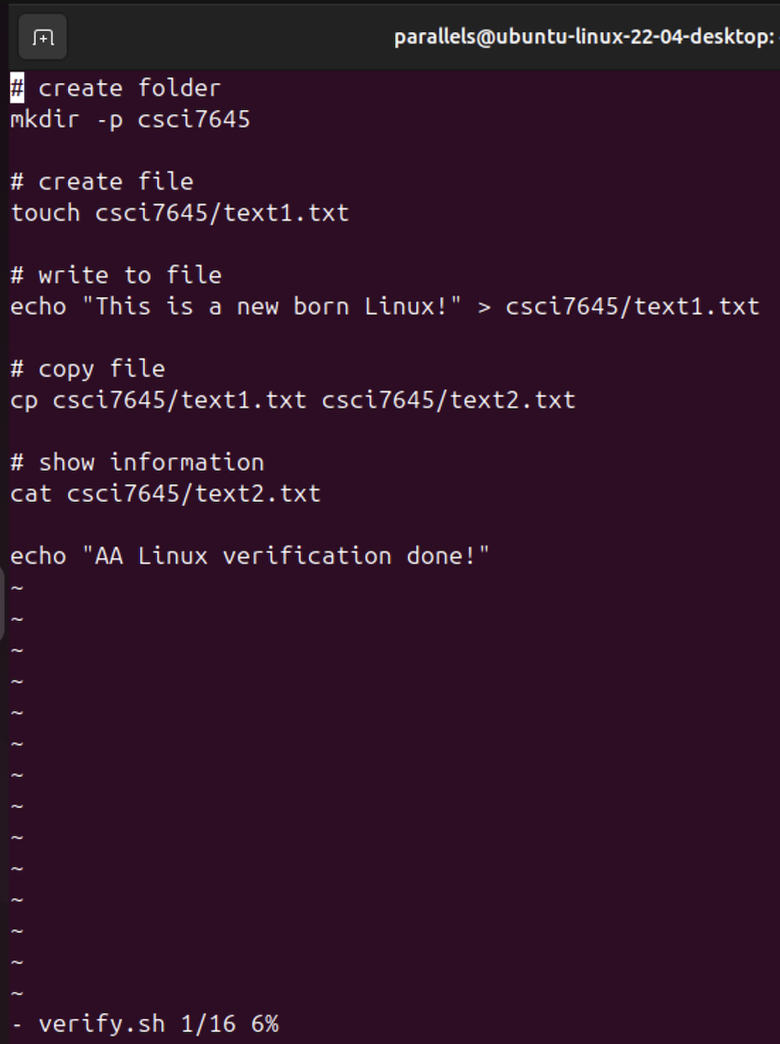


Verify by executing the script, and Job Done!
04
Verification – Test the basic functions of AA Linux.

Slide 22
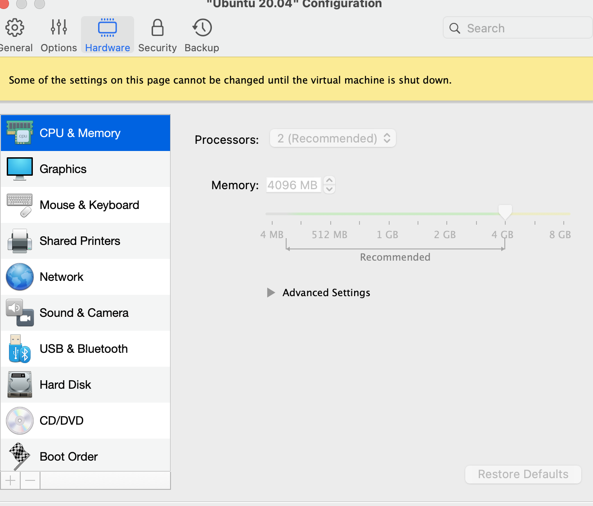
1. Insufficient virtual memory
04
Problems & Solutions
Sometimes, the “make” instruction failed to generate new Linux kernel mirror files due to the lack of the enough memory allocation to the virtual machine. And we can manually modify the memory space for the Ubuntu Linux which is running on the Parallel Desktop.

Slide 23
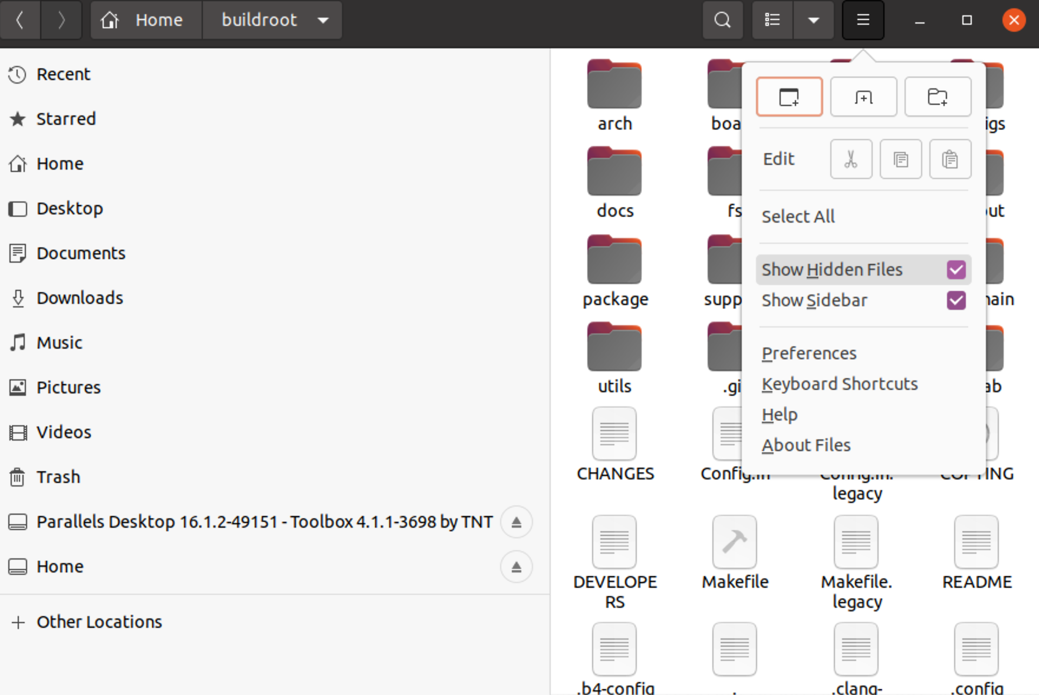
2. The modified configuration cannot take effect
04
Problems & Solutions
Solution:
Find the hidden file ‘.config’ and update it synchronously.
Clean up the old image file through “make clean”
Re-execute “make”

Slide 24
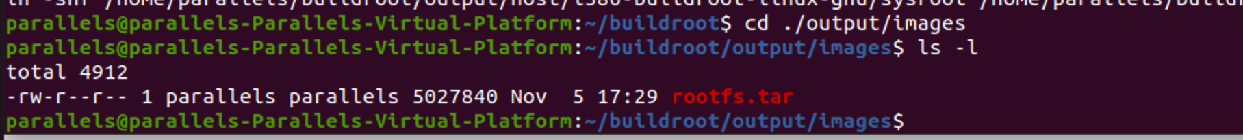
3. It is hard to detect error messages when building Linux.
04
Problems & Solutions
It is recommended to output the Log File for the further detection.

Slide 25

04
Conclusion
Completed course objectives
Used the Buildroot tool to configure and generate a simple Linux system according to specific requirements to meet the requirements of basic operating system application scenarios.
Gains in practice
Gain a preliminary understanding of the Linux system building process and master system customization skills, laying the foundation for subsequent research and practice in the field of system programming.

Slide 26

Thank you!
Q & A
Do you have any questions?
Please get in touch with us.
Thanks a lot！
Technical support：h.lin@student.fdu.edu
Copyright ©2024 CSCI-7645 V3 SP Group 5 Project All Rights Reserved.

